Slide 1

Practical 22
Program to Find the Count of Distinct Substrings

Slide 2

Lesson Plan
Subject/Course | Competitive Coding
Lesson Title | Program to Find the Count of Distinct Substrings
Lesson Objectives
Understand what substrings are and how to count them.
Learn how to find all distinct substrings in a given string.
Explore efficient methods using hashing or Trie.
Analyze time and space complexity of substring counting

Slide 3
Problem Statement:
Write a program to count the number of distinct substrings
in a given string.
The program should:
1. Take a string as input.
2. Find all unique substrings.
3. Return the count of those distinct substrings.

Slide 4
Concept
What is a Substring?
A substring is a continuous sequence of characters within a string. Example: For "abc", substrings are a, b, c, ab, bc, abc.
Total substrings = n × (n + 1) / 2 for a string of length n.
But we only want distinct substrings (no duplicates).

Slide 5
Concept
⚙️ Approaches
Brute Force: Generate all substrings and use a set — O(n²) substrings, O(n³) time (inefficient).
Trie-based Approach:
Insert all suffixes of the string into a Trie.
Each new branch in the Trie represents a new distinct substring.
Count total Trie nodes = total distinct substrings + 1 (for empty string).

Slide 6
Algorithm/Logic
1. Initialize an empty HashSet.
2. Generate all substrings using two loops:
- Outer loop for start index.
- Inner loop for end index.
3. Add each substring to the HashSet.
4. The size of the HashSet gives the distinct substring count.

Slide 7
Visualization
Example:
Input: "aba"
All substrings:
a, b, a, ab, ba, aba
Distinct substrings:
a, b, ab, ba, aba
Count = 5

Slide 8
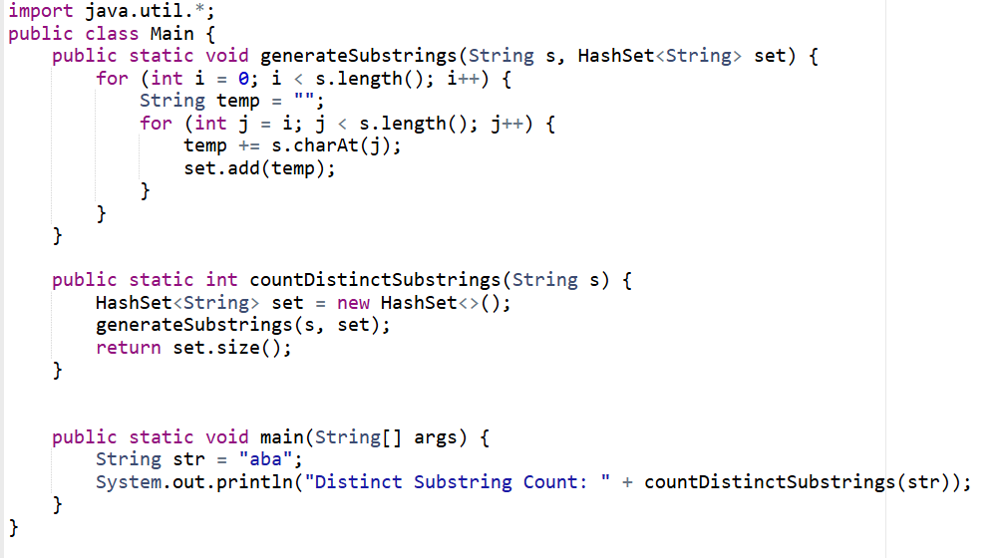
Code Implementation

Slide 9

Output

Slide 10
Example Walkthrough
1. Start = 0 → Substrings: a, ab, aba
2. Start = 1 → Substrings: b, ba
3. Start = 2 → Substrings: a
4. Unique ones stored in HashSet.
5. Final count = 5.

Slide 11
Time & Space Complexity
Time Complexity:
O(n²) – two nested loops for substring generation.
Space Complexity:
O(n²) – storing all substrings in the HashSet.

Slide 12
Summary
1. Substrings are continuous character sequences.
2. Use HashSet to remove duplicates automatically.
3. Total time complexity is O(n²).
4. Simple and effective approach for small strings.

Slide 13
Practice Questions:
1. Repeated Substring Pattern — LeetCode #459
🔗 https://leetcode.com/problems/repeated-substring-pattern/
Concept: Check if the given string can be formed by repeating a substring.
Why Practice: Related to substring structure and repetition detection.

Slide 14
Practice Questions:
2. Longest Substring Without Repeating Characters — LeetCode #3
🔗https://leetcode.com/problems/longest-substring-without-repeating-characters/
Concept: Sliding window and unique substring logic.
Why Practice: Reinforces unique substring concepts.

Slide 15
Practice Questions:
3. Count Unique Substrings – LeetCode #1698
🔗 https://leetcode.com/problems/number-of-distinct-substrings-in-a-string/
Concept: Use Trie (Prefix Tree) or Suffix Array to count the number of distinct substrings efficiently.
Why Practice: This problem is a direct application of the practical — it strengthens understanding of Trie-based substring counting, suffix generation, and string manipulation.

Slide 16
Thanks

